Slide 2
.NET Core 3 e i microservizi
Andrea Tosato – Microsoft MVP (Azure)

Slide 3

RELEASED
.NET Core 3.0
WPF and Windows Forms support
Side-by-side support & self-contained EXEs
Full-stack web development with C# and Razor
New C# 8.0 language features
dot.net/get-core3

Slide 4
Novità in .NET Core 3
Per sviluppatori web

Slide 5
Tutte le novità
C# 8.0
Ranges and indices
Async streams
.NET Standard 2.1
Span<T>, ValueTask<T>, Reflection Emit, SIMD
Single-file executables
Assembly linking
Tiered compilation
ReadyToRun images

Slide 6
Tutte le novità
IEEE Floating-point improvements
Fast built-in JSON support
System.Text.Json
HTTP/2 support
TLS 1.3 & OpenSSL 1.1.1 on Linux
Cryptography ciphers
AES-GCM
AES-CCM
Cryptographic Key Import/Export

Slide 7
Tutte le novità
SerialPort for Linux
Docker and cgroup memory Limits
Smaller Garbage Collection heap sizes
Garbage Collection Large Page support
GPIO Support for Raspberry Pi
ARM64 Linux support
Linux
Windows support isn't yet available

Slide 8
Tiered Compilation
il motore Just-In-Time (JIT) produce più versioni native di metodi aumentandone la velocità di esecuzione. Viene prodotta inizialmente una versione meno ottimizzata, ma più veloce nello startup, così da migliorare il cold startup, fino a produrre in background versioni più ottimizzate e quindi più veloci che sfruttano al massimo la capacità della CPU. Questa funzionalità si può eventualmente disabilitare agendo sulle proprietà di progetto, come mostrato nell'esempio.
<TieredCompilation>false</TieredCompilation>

Slide 9
Tiered Compilation
Con questa funzionalità lo startup degli applicativi diminuisce fino al 35% mentre le capacità di esecuzione delle pagine possono aumentare anche del 60%.

Slide 10
Single-file executable
Con questa opzione possiamo ottenere un solo exe/eseguibile che contenga tutto il necessario affinché l'applicativo funzioni. Questo file alla prima esecuzione scompatta tutte le dll e le dipendenze in una cartella temporanea e lancia l'app.
<PropertyGroup>
<RuntimeIdentifier>win10-x64</RuntimeIdentifier>
<PublishSingleFile>true</PublishSingleFile>
</PropertyGroup>

Slide 11
Single-file executable
La prima esecuzione rallenta notevolmente il cold startup perciò lo rende più ideale in ambiti desktop dove si vuole privilegiare la facilità di distribuzione
File statici, come la cartella wwwroot degli applicativi web, non vengono inclusi e vanno distribuiti a parte.

Slide 12
Publish Trimmed
Con l'assembly linking possiamo pubblicare un applicativo che contenga solo lo stretto necessario con ciò che effettivamente utilizziamo. Quando produciamo una self contained app, infatti, con o senza single-file executable, vengono incluse tutte le DLL di .NET Core 3.0, andando a produrre un set di file per un totale di 65MB. Ci basta aggiungere una opzione nel file csproj come mostrato nell'esempio, per produrre un output che passa, nel caso di una semplice console app, fino a 25MB.
<PropertyGroup>
<PublishTrimmed>true</PublishTrimmed>
</PropertyGroup>

Slide 13
Publish Trimmed
Per ottenere questo risultato vengono omessi interi assembly che non utilizziamo, anche se eventualmente può arrivare anche ad escludere classi o membri. Anche in questo caso la funzionalità è più pensata per l'ambito desktop principalmente perché nella distribuzione in su server qualche MB non fa la differenza
<ItemGroup>
<TrimmerRootAssembly Include="System.IO.FileSystem" />
</ItemGroup>

Slide 14
Ready To Run
produce in fase di pubblicazione una versione delle dll contenente già la versione nativa, molto simile a quando produrrebbe il jitter. In questo modo aumentiamo la velocità di startup poiché il binario è già pronto. Per garantire il funzionamento di scenari dinamici, la dll contiene sia l'IL originale, sia la versione nativa
<PropertyGroup>
<PublishReadyToRun>true</PublishReadyToRun>
</PropertyGroup>

Slide 15
HTTP/2
var client = new HttpClient()
{
BaseAddress = new Uri("https://localhost:5001"),
DefaultRequestVersion = new Version(2, 0)
};
// HTTP/2 abilitato sul client
using var response = await client.GetAsync("/");
var client2 = new HttpClient();
// HTTP/2 abilitato sulla SINGOLA richiesta
using var request = new HttpRequestMessage(HttpMethod.Get, "/")
{ Version = new Version(2, 0) }
using var response = await client2.SendAsync(request)

Slide 16
ASP.NET Core 3.0
gRPC
High performance contract-based RPC services with .NET
Works across many languages and platforms
Worker Service
Starting point for long running back processes like Windows Server or Linux daemon
Producing or consuming messages from a message queue
Web API’s + Identity
Add security and authentication to Web API’s
Notes:
We’ve added a ton of features to ASP.NET Core in version 3.0 on order to make building resilient microservices easier.

Slide 17
ANNOUNCING
Microsoft Sponsorship for Open Source Projects
gRPC
IdentityServer
Swashbuckle
github.com/grpc
github.com/identityserver
github.com/domaindrivendev/swashbuckle

Slide 18
Healthchecks

Slide 19
ASP.NET Core Healthchecks
Healthchecks
public class BasicStartup
{
public void ConfigureServices(IServiceCollection services)
{
services.AddHealthChecks();
}
public void Configure(IApplicationBuilder app)
{
app.UseRouting();
app.UseEndpoints(endpoints =>
{
endpoints.MapHealthChecks("/health");
});
}
}
Microsoft.AspNetCore.Diagnostics.HealthChecks
https://aka.ms/healthchecks

Slide 20
ASP.NET Core Healthchecks
Healthchecks
public class BasicStartup
{
public void ConfigureServices(IServiceCollection services)
{
services.AddHealthChecks().AddDatabaseChecks();
}
public void Configure(IApplicationBuilder app)
{
app.UseRouting();
app.UseEndpoints(endpoints =>
{
endpoints.MapHealthChecks("/health");
});
}
}
Microsoft.AspNetCore.Diagnostics.HealthChecks https://aka.ms/healthchecks

Slide 21
Docker Images

Slide 22
Docker images
Debian base images
/dotnet/core/aspnet:2.2-stretch-slim 261 MB
/dotnet/core/aspnet:3.0-buster-slim
207 MB
/dotnet/core/runtime:3.0-buster-slim
189 MB
/dotnet/core/runtime:3.0-alpine 88 MB
Alpine base images
/dotnet/core/aspnet:2.2-alpine 166 MB
/dotnet/core/aspnet:3.0-alpine
106 MB
Base address is mcr.microsoft.com

Slide 23
Worker Service
Notes:
There is a new microservices related Worker Service project template for building lightweight background workers, which can be run under orchestrators like Kubernetes.

Slide 24
Worker Service & GenericHost
public static IHostBuilder CreateHostBuilder(string[] args)
{
return Host.CreateDefaultBuilder(args)
.ConfigureServices(hostContext, services) =>
{
services.AddHostedService<Worker>();
});
}
Notes:
Works on a GenericHost. What is a generic host, it’s just that generic. It works in the same pattern as ASP.NET but without anything web specific.
The web host is preconfigured to boot Kestrel, this one is not. All it does is if you have any services in your app that is a Hosted Service, it will run them.
In this snippet, Worker is the service, inherits from BackgroundService but could also inherit from IHostedService.

Slide 25
Windows Service
Worker Service : Windows
public static IHostBuilder CreateHostBuilder(string[] args) =>
Host.CreateDefaultBuilder(args)
.UseWindowsService()
.ConfigureServices((hostContext, services) =>
{
services.AddHostedService<Worker>();
});
Add a NuGet Package Microsoft.Extensions.Hosting.WindowsServices

Slide 26
systemd service
Worker Service : systemd
public static IHostBuilder CreateHostBuilder(string[] args) =>
Host.CreateDefaultBuilder(args)
.UseSystemd()
.ConfigureServices((hostContext, services) =>
{
services.AddHostedService<Worker>();
});
Add a NuGet Package Microsoft.Extensions.Hosting.Systemd

Slide 27
Demo
Notes:
Worker service sidecar.

Slide 28
EndPoint Routing
Notes:
In the microservices world, each services you create does a specific process. In previous versions of .NET or ASP.NET Core specifically MVC was included in order to get the routing.
However, many of the APIs we are developing are just maybe the M and C of MVC or maybe not of the letters.

Slide 29
EndPoint Routing
https://aka.ms/endpointrouting
public class Startup
{
public void ConfigureServices(IServiceCollection services) { }
public void Configure(IApplicationBuilder app, IWebHostEnvironment env)
{
if (env.IsDevelopment())
{
app.UseDeveloperExceptionPage();
}
app.UseRouting();
app.UseEndpoints(endpoints =>
{
endpoints.MapGet("/hello", async context =>
{
await context.Response.WriteAsync("Hello World!");
});
});
}
}
Notes:
Here is a very basic service that just returns HelloWorld on the /hello path. No MVC needed to route or respond to the HTTP request. We saw a similar pattern in the HealthChecks example under the /health route.
Simply add the statement app.UseRouting(); and then app.UseEndPoints and map your routes

Slide 30
New Options for MVC Service Registration
AddControllers. This method is used when you are building a web API and don't need any server-side views
AddControllersWithViews. You use this method when you are building an application that needs a web API and server-side views
AddRazorPages. You need this method when your application uses Razor Pages — that is, pages using the Razor template markup syntax.

Slide 31
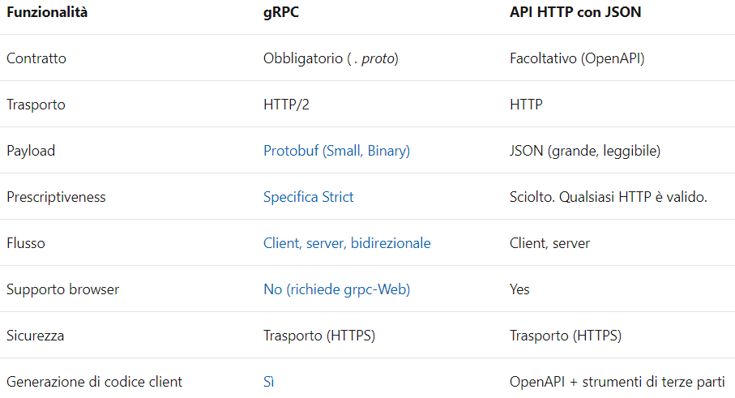
gRPC vs REST

Slide 32
Scenari Consigliati
Microservizi – bassa latenza e velocità effettiva elevata.
Comunicazione in tempo reale da punto a punto –push dei messaggi in tempo reale senza polling.
Ambienti poliglotti – gli strumenti gRPC supportano tutti i linguaggi di sviluppo più diffusi.
Ambienti vincolati alla rete – formato di messaggio leggero.

Slide 33
Punti Deboli
Supporto browser limitato
Solo grpc-Web (https://grpc.io/docs/tutorials/basic/web/)
Payload non leggibile
Protobuf richiede la descrizione dell'interfaccia del messaggio specificata nel file . proto per la deserializzazione corretta
Lo Streaming viene su una connessione Client-Server. Non esiste il concetto di “Clients connessi”

Slide 34
Punti Deboli
Non è attualmente supportato nel servizio app Azure o in IIS. L'implementazione HTTP/2 di http. sys non supporta le intestazioni finali della risposta HTTP su cui si basa gRPC

Slide 35
.NET Core 3.0 Microservices
DEMO
gRPC

Slide 36
What’s new in SignalR in .NET Core 3.0

Slide 37
Long polling
Client
Server
Request
Response
Event
Request

Slide 38
Server-sent events
Client
Server
new EventSource(…)
Message
Event
Message
Event
Message
Event

Slide 39
WebSockets
Client
Server
upgrade: websocket
HTTP/1.1 101 Switching Protocols
👍
🙂
messages
🙂

Slide 40
Client-to-server Streaming
Notes:
Streaming demos

Slide 41
Server-to-client Streaming
Notes:
Streaming demos

Slide 42

What if the connection…

Slide 43

What if the connection breaks?

Slide 44
Automatic Reconnections

Slide 45
Scale out with Azure SignalR Service

Slide 46
Azure SignalR Service
Offload ASP.NET Core SignalR scale-out to a managed service
Free tier – Up to 20 connections
Pay for “units” of 1,000 connections, up to 100,000 connections
Add NuGet package and 1 line of code

Slide 47
ASP.NET
Core app
Business Logic (Hub)
Pages
SignalR traffic
Client
Web traffic

Slide 48

Azure SignalR Service
ASP.NET
Core app
Business Logic (Hub)
Server Endpoint
Pages
Client Endpoint
Client
Web traffic
SignalR traffic

Slide 49
Demo
Notes:
Worker service sidecar.

Slide 50
Web apps with Blazor

Slide 51
ASP.NET Core 3.0 Blazor
Full stack web development with C#
You don’t need to know AngularJS, React, Vue, etc.
Take advantage of stability and consistency of .NET
Runs in all browsers
Strongly typed on the client and server
Share C# code with the client and server
Web Assembly (In Preview, Release in May 2020)
Native performance
Requires no plugin or code transpilation
Notes:
Blazor is a new client-side web UI framework based on .NET and C# instead of JavaScript.
.NET has always had great support for building server-rendered web apps with ASP.NET, where your .NET code runs on the server and generates HTML & JSON responses. But if you ever wanted to add some client-side functionality to your web app that runs in the browser on the user's device, that meant you had to write some JavaScript.
Well, not anymore! Blazor enables full-stack web development with .NET using only open web standards. .NET Core 3.0 ships support for Blazor Server apps, which enables you to handle client-side UI interactions over a real-time SignalR connection. And in the near future with Blazor WebAssembly you'll be able to run your .NET code directly in the browser on WebAssembly-based .NET runtime.

Slide 52







https://...
JS

Slide 53


Blazor
Build client-side web UI with .NET instead of JavaScript
Write reusable web UI components with C# and Razor
Share .NET code with both the client and the server
Call into JavaScript libraries & browser APIs as needed
C#

Slide 54

How Blazor WebAssembly works
https://...
Razor Components
DOM
.NET
WebAssembly
https://www.nuget.org/packages/Microsoft.AspNetCore.Blazor.Templates/3.0.0-preview9.19465.2

Slide 55
Blazor on client or server
Blazor WebAssembly
Blazor Server
https://...
https...
.NET Core
Razor Components
DOM
SignalR
DOM
.NET
WebAssembly
Razor Components
.NET
May 2020
.NET Core 3.0

Slide 56
Blazor on client or server
Blazor WebAssembly
Blazor Server
Pro:
True SPA, full interactivity
Utilize client resources
Supports offline, static sites, PWA scenarios
Con:
Larger download size
Requires WebAssembly
Still in preview
Pro:
Smaller download size, faster load time
Running on fully featured .NET runtime
Code never leaves the server
Simplified architecture
Con:
Latency
No offline support
Consumes more server resources
May 2020
.NET Core 3.0

Slide 57
Get started with Blazor
Go to https://blazor.net
Install .NET Core 3.0
Install the Blazor WebAssembly template
(Windows) Install Visual Studio 2019 16.3
(Mac/Linux) Install Visual Studio Code with the C# extension

Slide 58
Blazor
Notes:
Creating components
Using components
Component parameters
Routing
Layouts
Dependency injection
Event handling
Data binding
Forms & validation
JS interop
Use local storage
Using .NET Standard libraries

Slide 59
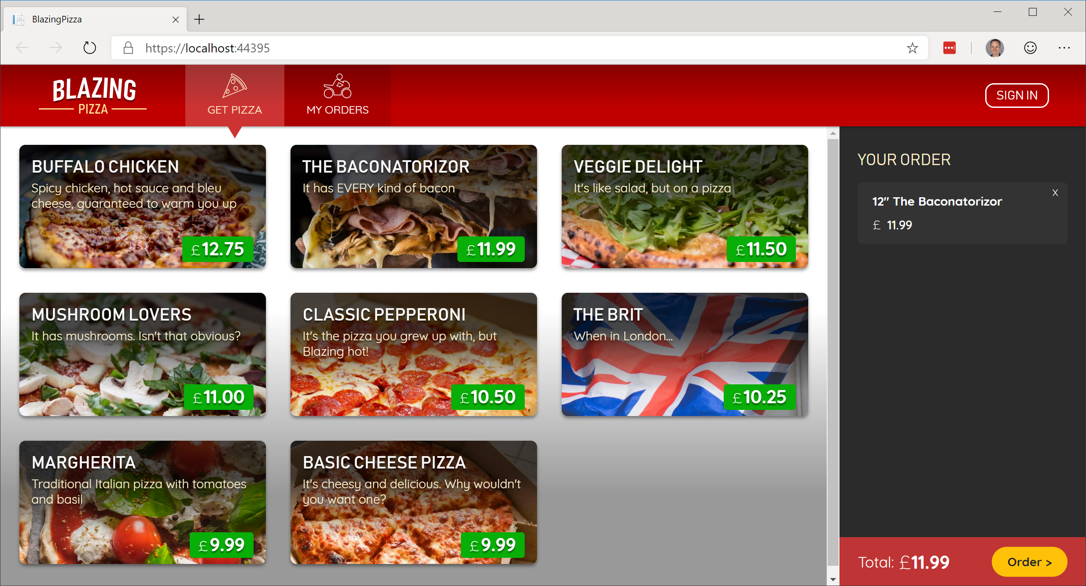
Build your own pizza store UI with Blazor
https://aka.ms/blazorworkshop

Slide 60
The “Awesome Blazor” community
https://aka.ms/awesomeblazor
Free open-source components & JS interop libraries
Lots of fun sample Blazor apps
Articles, videos, blogs, and other learning materials
Chat with the Blazor community on Gitter: https://gitter.im/aspnet/blazor
Thank you, Simon and Chris!

Slide 61
Blasteroids
https://aka.ms/blasteroids

Slide 62
Summary
Blazor Server now available with .NET Core 3.0
Build full-stack web apps with C# and .NET
Rich component model and UI framework
Integrates with existing ASP.NET Core apps
Blazor WebAssembly coming in May 2020

Slide 63
Try Blazor today!
Blazor: https://blazor.net
Docs: https://blazor.net/docs
.NET Core 3.0: https://dot.net/get-core3
Visual Studio: https://visualstudio.com/
Workshop: https://aka.ms/blazorworkshop
Community: https://aka.ms/awesomeblazor

Slide 64
Blazor
DEMO

Slide 65
The Future of Blazor on the Client

Slide 66






So many platforms, so little time…
?

Slide 67
Web
Blazor Server
Web app
Every interaction handled on server
Prerendered HTML (optional)
Blazor WebAssembly
Web app with client-side execution
Loaded from web server
Can work offline via Service Worker
Desktop
+ Mobile

Slide 68
Web
Blazor Server
Web app
Every interaction handled on server
Prerendered HTML (optional)
Blazor WebAssembly
Web app with client-side execution
Loaded from web server
Can work offline via Service Worker
Blazor PWA – OS installed
Appears as native app (own window)
Works offline or online
Desktop
+ Mobile

Slide 69
What is a PWA?
Progress Web App (PWA): A web app that users modern web standards to provide a closer-to-native user experience.
Works offline
Push notifications
Fast & responsive
OS installable

Slide 70
Web
Blazor Server
Web app
Every interaction handled on server
Prerendered HTML (optional)
Blazor WebAssembly
Web app with client-side execution
Loaded from web server
Can work offline via Service Worker
Blazor PWA – OS installed
Appears as native app (own window)
Works offline or online
Blazor Hybrid
Native .NET renders to Electron / WebView
Appears as native app (own window)
Works offline or online
Desktop
+ Mobile

Slide 71
Web
Blazor Server
Web app
Every interaction handled on server
Prerendered HTML (optional)
Blazor WebAssembly
Web app with client-side execution
Loaded from web server
Can work offline via Service Worker
Blazor PWA – OS installed
Appears as native app (own window)
Works offline or online
Blazor Hybrid
Native .NET renders to Electron / WebView
Appears as native app (own window)
Works offline or online
Desktop
+ Mobile
Blazor Native
Same programming model, but
rendering non-HTML UI

Slide 72
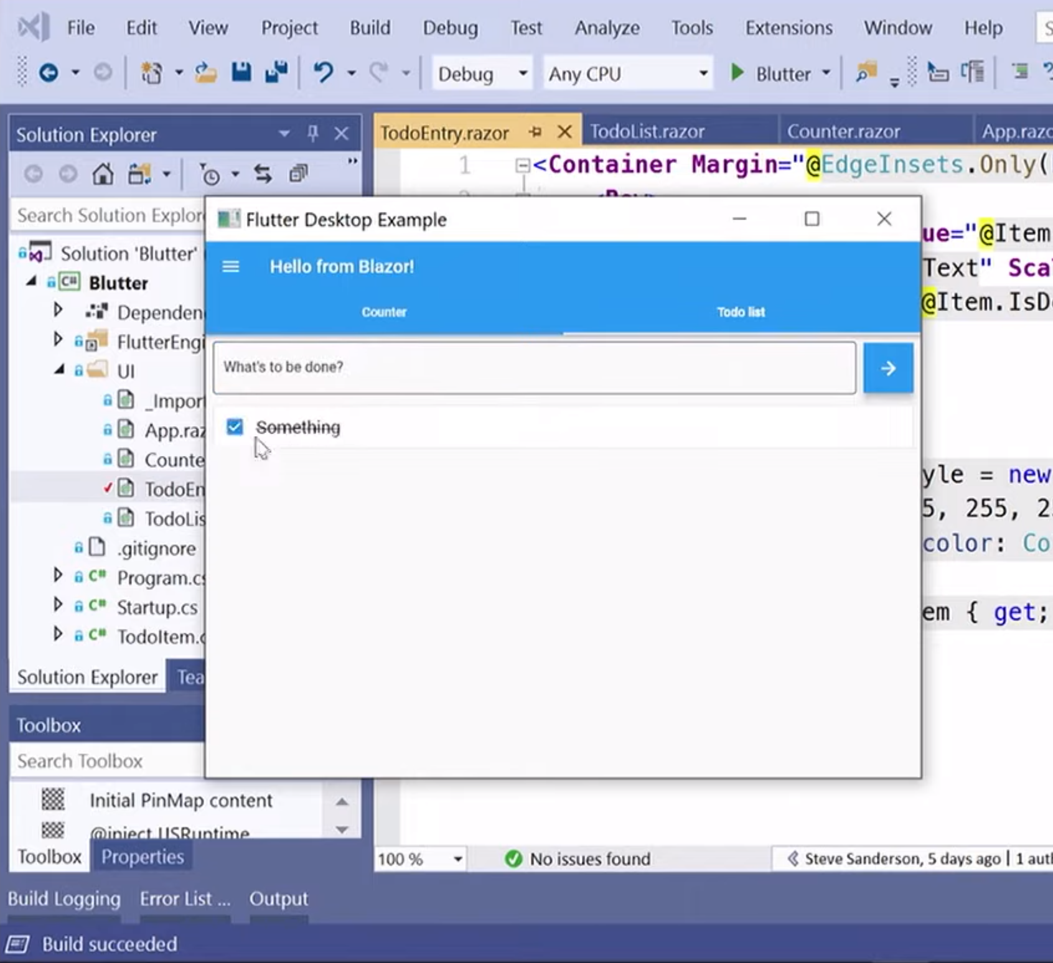
Blazor Native
By default, Blazor renders to HTML
But the rendering layer is replaceable
Possible to render to native controls instead
Currently exploring different options
https://aka.ms/blutter

Slide 73
Blazor roadmap
Blazor Server – Shipped with .NET Core 3.0!
Blazor WebAssembly – May 2020
Blazor PWA & Electron – Previews with .NET 5
Blazor Native – Under investigation

Slide 74
.NET 5

Slide 75
.NET 5
.NET
.NET FRAMEWORK
.NET CORE
.NET
XAMARIN / MONO
Runtime (JIT & Native)
Runtime
Runtime
Runtime
One Base Class Library
Base Class Library
Core Library
Mono Class Library
.NET STANDARD
Notes:
2019 – Introduce .NET 5 – Windows, Mac, Linux, Android, IOS all run .NET Core’s runtime
Same BCL used on all platforms, same runtime used on all platforms
Native code compilation on all platforms, by merging .NET Native and Mono AOT
JIT and AOT Runtime
.NET 5 is the next major version of the .NET Platform that brings technologies from .NET Framework, .NET Core and & Mono runtimes and frameworks together into one .NET platform.
.NET 5 will have one Base Class Library (BCL) that will contain APIs for building any type of application. All .NET workloads are supported with application frameworks including cross-platform web development with ASP.NET, iOS and Android mobile development with Xamarin, Windows Desktop, and cross-platform IoT.
.NET 5 will have both Just-in-Time (JIT) and Ahead-of-Time (AOT) compilation models for the multiple compute and device scenarios it must support. JIT has better performance for server and desktop workloads as well as development environments. AOT has better startup, a small footprint, and is required for mobile and IoT devices.
.NET 5 will also have one unified toolchain supported by new SDK project types, will have a flexible deployment model (Side-by-Side and self-contained EXEs) and continue .NET Core's superior performance for server & cloud workloads.

Slide 76
.NET Schedule
July 2019
.NET Core 3.0
RC
Sept 2019
.NET Core 3.0
Nov 2019
.NET Core 3.1
LTS
Nov 2020
.NET 5.0
Nov 2021
.NET 6.0
LTS
Nov 2022
.NET 7.0
Nov 2023
.NET 8.0
LTS
.NET Core 3.0 released today!
.NET Core 3.1 = Long Term Support (LTS)
.NET 5.0 release in November 2020
Major releases every year, LTS for even numbered releases
Predictable schedule, minor releases if needed

Slide 77














Download .NET Core 3.0 Today!
dot.net/get-core3
visualstudio.com/downloads
DESKTOP
WEB
CLOUD
MOBILE
GAMING
IoT
AI
.NET

Slide 78
New free e-books
https://dotnet.microsoft.com/learn/dotnet/architecture-guides

